Slide 1

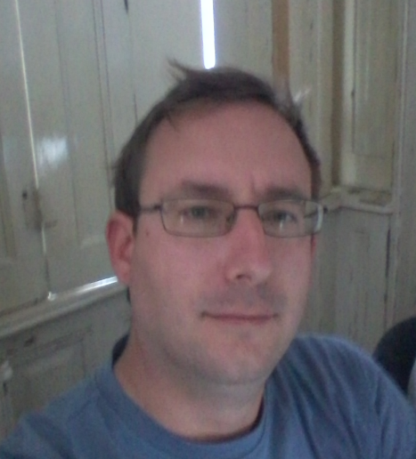
Péter JOLÁNKAI
1st DEMO
06.10.2017
Pallida Cohort - Static Class

Slide 2
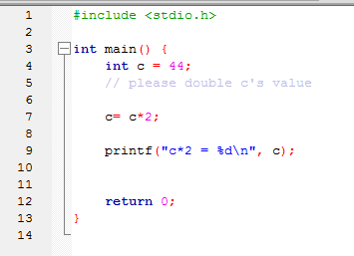
Starting a bootcamp is not easy
Improvement of coding in 2 days from multiplication

Slide 3

To rocket science

Slide 4
Biggest challenges:
;
()
}

Slide 5
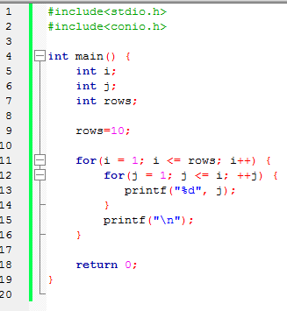

And a lot of succesfull small programmes running in C
like this:

Slide 6


May the Fox be with you!

